Slide 1

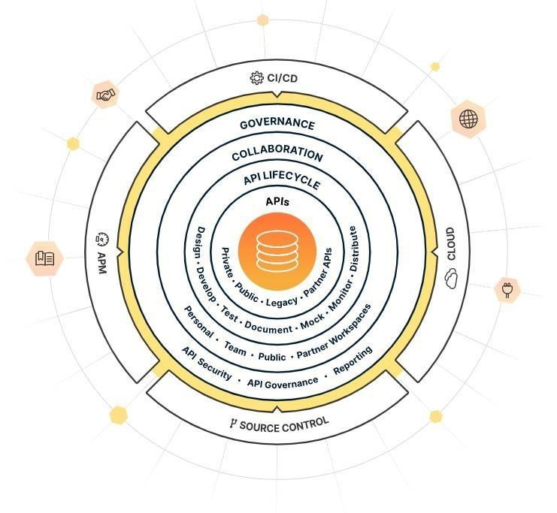

Slide 2
Outline
Introduction to Postman Tool
Features of Postman Tool Benefits of Postman Tool How to Use Postman Tool Postman Tool Pricing Conclusion

Slide 3

▶ Postman is a powerful API development and collaboration tool that simplifies the process of working with APIs. It provides a user-friendly interface for designing, testing, and documenting APIs, making it a popular choice among developers.
▶ With Postman, you can easily make HTTP requests to API endpoints, send different types of requests (GET, POST, PUT, DELETE, etc.), set headers, add request parameters, and handle authentication. It allows you to examine the responses and validate the functionality of your APIs.

Slide 4
▶ One of the key advantages of Postman is its ability to organize requests into collections and folders. This helps in maintaining a structured workflow and allows for better management and documentation of APIs. You can add descriptions and tags to requests, making it easier for you and your team to understand the purpose and usage of each request.
▶ Postman also provides environment variables, which are placeholders for dynamic values used in requests. This allows you to configure different environments (e.g., development, staging, production) and switch between them seamlessly. You can set variables for URLs, authentication credentials, or any other values that change based on the environment, saving you time and effort.

Slide 5
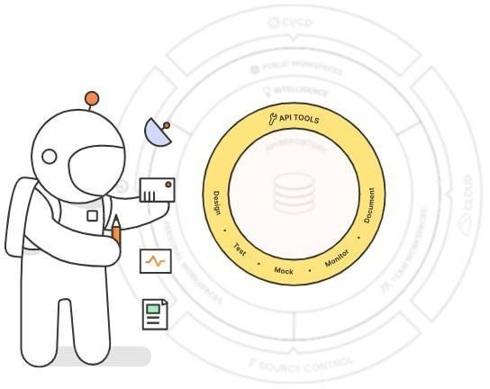
▶ API Request Building: Postman provides a user-friendly interface for constructing API requests. You can easily specify the HTTP method (GET, POST, PUT, DELETE, etc.), set headers, define request parameters, and add request bodies.
▶ API Testing: You can send API requests and examine the responses within Postman. It allows you to verify the correctness of API responses, inspect response headers and bodies, and validate the expected behavior of your APIs.

Slide 6
▶ Collections and Workspaces: Postman enables you to organize your API requests into collections and folders. This allows for better management and documentation of APIs. You can create multiple collections for different projects and switch between them seamlessly. Workspaces provide a way to organize collections into groups, making it easier to manage and collaborate on large projects.
▶ Environment Variables: Postman supports the use of environment variables, which allow you to define dynamic values that can be reused across requests. You can set variables for URLs, authentication tokens, or any other values that change based on different environments (development, staging, production). This flexibility simplifies the process of switching between environments and reduces duplication of effort.

Slide 7
▶ Collaboration and Sharing: Postman facilitates team collaboration by providing features for sharing collections, documentation, and test suites. You can invite team members to collaborate on projects, assign roles and permissions, and track changes made by different users. It also integrates with popular version control systems, enabling seamless collaboration within existing development workflows.
▶ API Documentation: Postman allows you to generate interactive API documentation from your collections. The documentation includes descriptions, request/response examples, and the ability to make requests directly from the documentation itself. It provides a user-friendly interface for other developers to understand and consume your APIs.

Slide 8
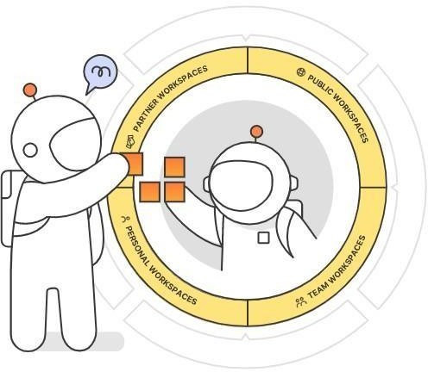
Benefits of postman tool
Postman offers several benefits for API development and testing. Here are some key benefits of using Postman:
▶ Increased Productivity: Postman provides a user-friendly interface that simplifies the process of working with APIs. Its intuitive design and features like request organization, environment variables, and automated testing help streamline API development workflows, saving time and increasing productivity.
▶ Rapid API Prototyping: With Postman, you can quickly prototype and test APIs without the need for a fully implemented backend. Using mock servers, you can simulate API responses and validate frontend applications against expected behavior. This allows for faster iteration and feedback during the development process.

Slide 9
Benefits of postman tool
▶ Efficient API Testing: Postman allows you to create and execute automated tests for APIs. This helps in ensuring the reliability and correctness of your APIs by validating response codes, performing assertions on response bodies, and verifying specific data points. Automated testing saves effort and time compared to manual testing.
▶ Enhanced Collaboration: Postman facilitates collaboration among team members working on API projects. It provides features for sharing collections, documentation, and test suites. Team members can work together, track changes, and assign roles and permissions within the tool. This promotes better communication and coordination among team members.

Slide 10
Benefits of postman tool
▶ Improved Documentation: Postman allows you to generate interactive API documentation from your collections. The documentation includes descriptions, request/response examples, and the ability to make requests directly from the documentation itself. This makes it easier for developers to understand and consume your APIs and reduces the effort required to create and maintain separate API documentation.
▶ Community and Learning Resources: Postman has a vibrant community of developers who share knowledge, tips, and best practices related to API development. The Postman community provides a platform to learn from others, ask questions, and stay updated with the latest developments in the API space.

Slide 11
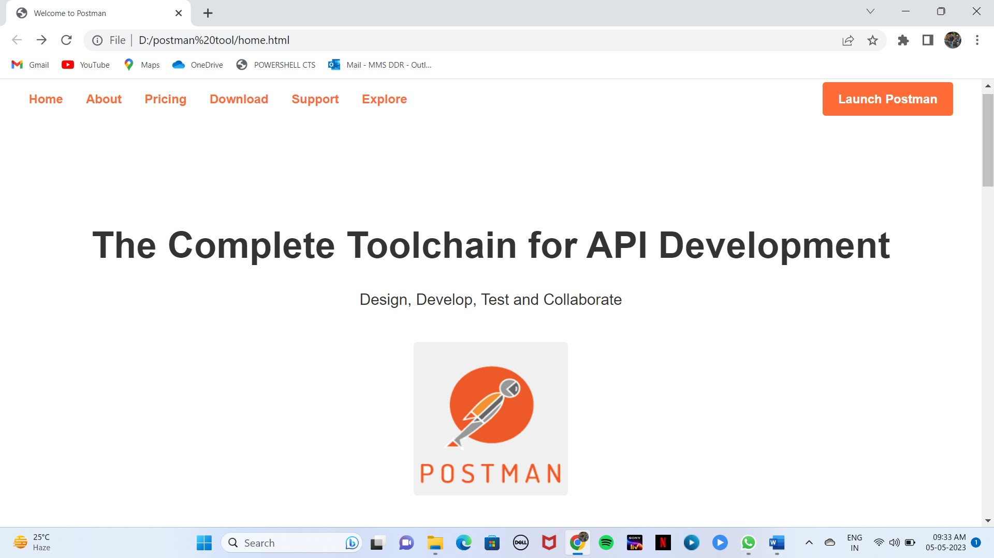
How to use postman tool clone

Slide 12
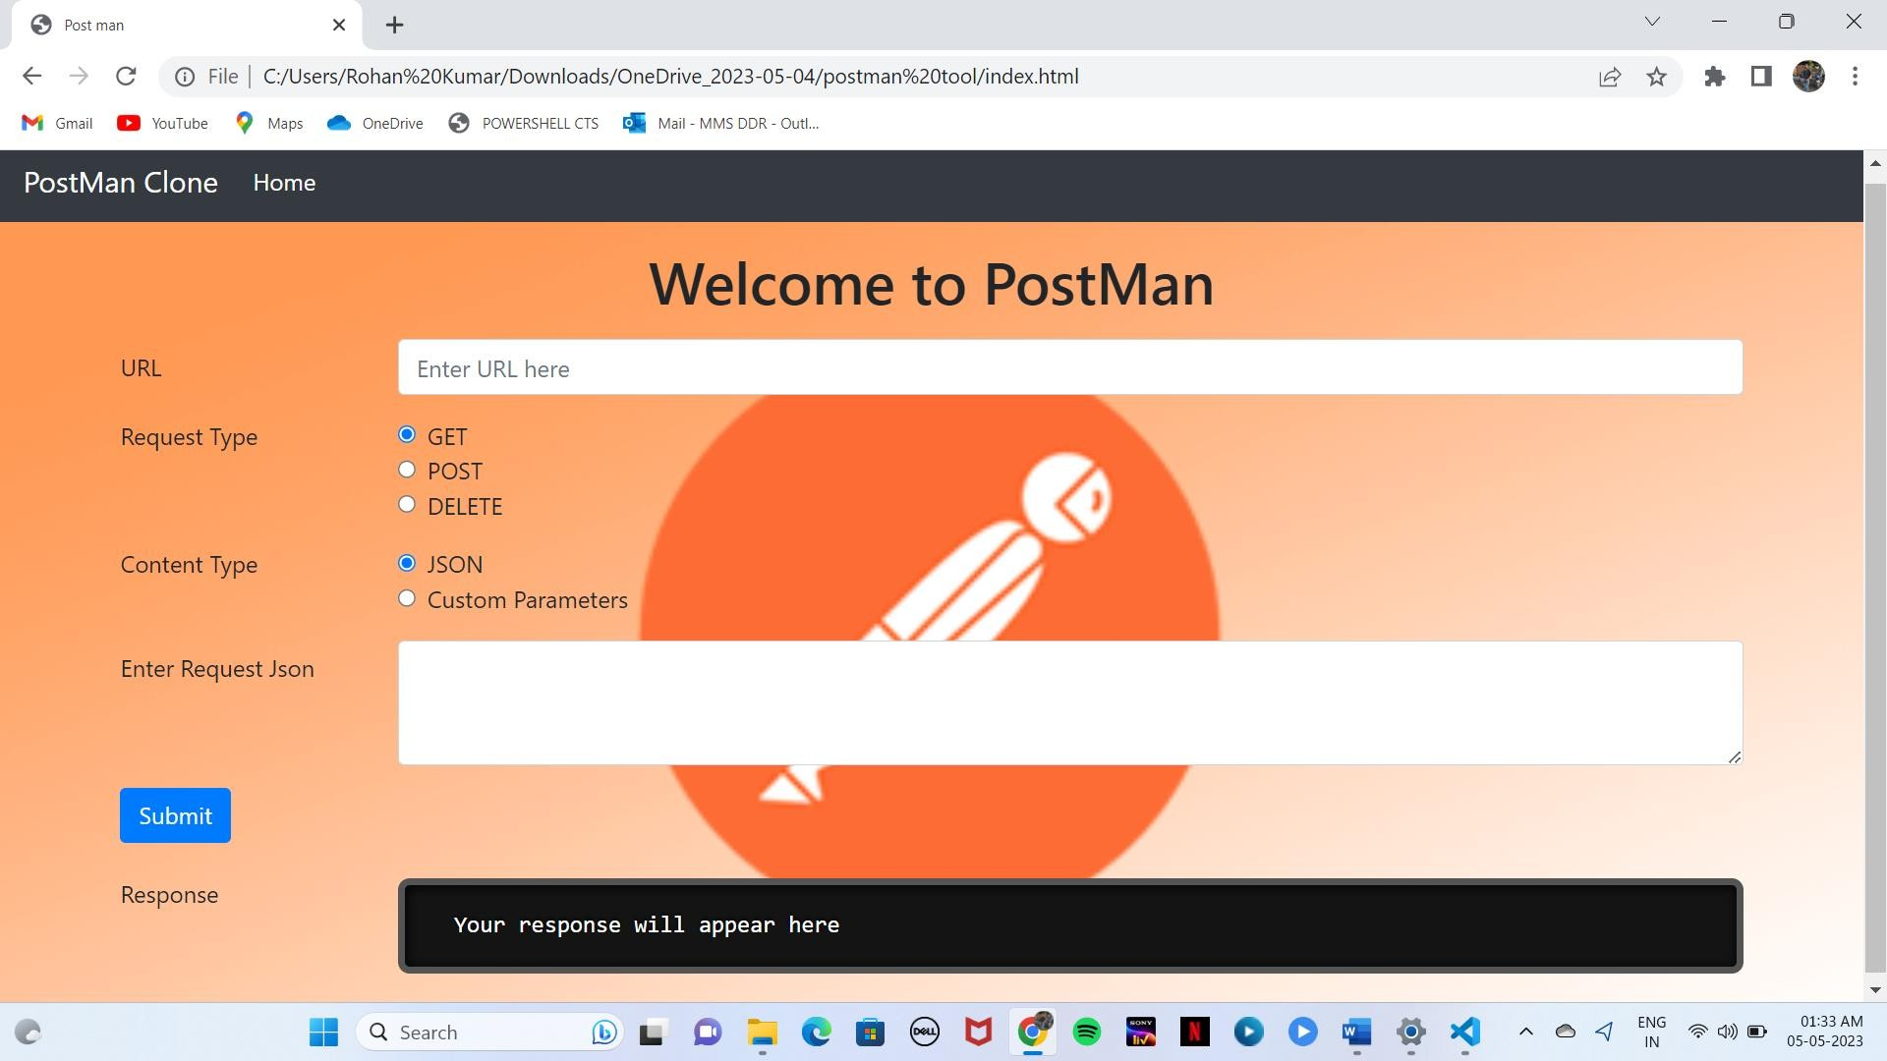
How to use postman tool

Slide 13
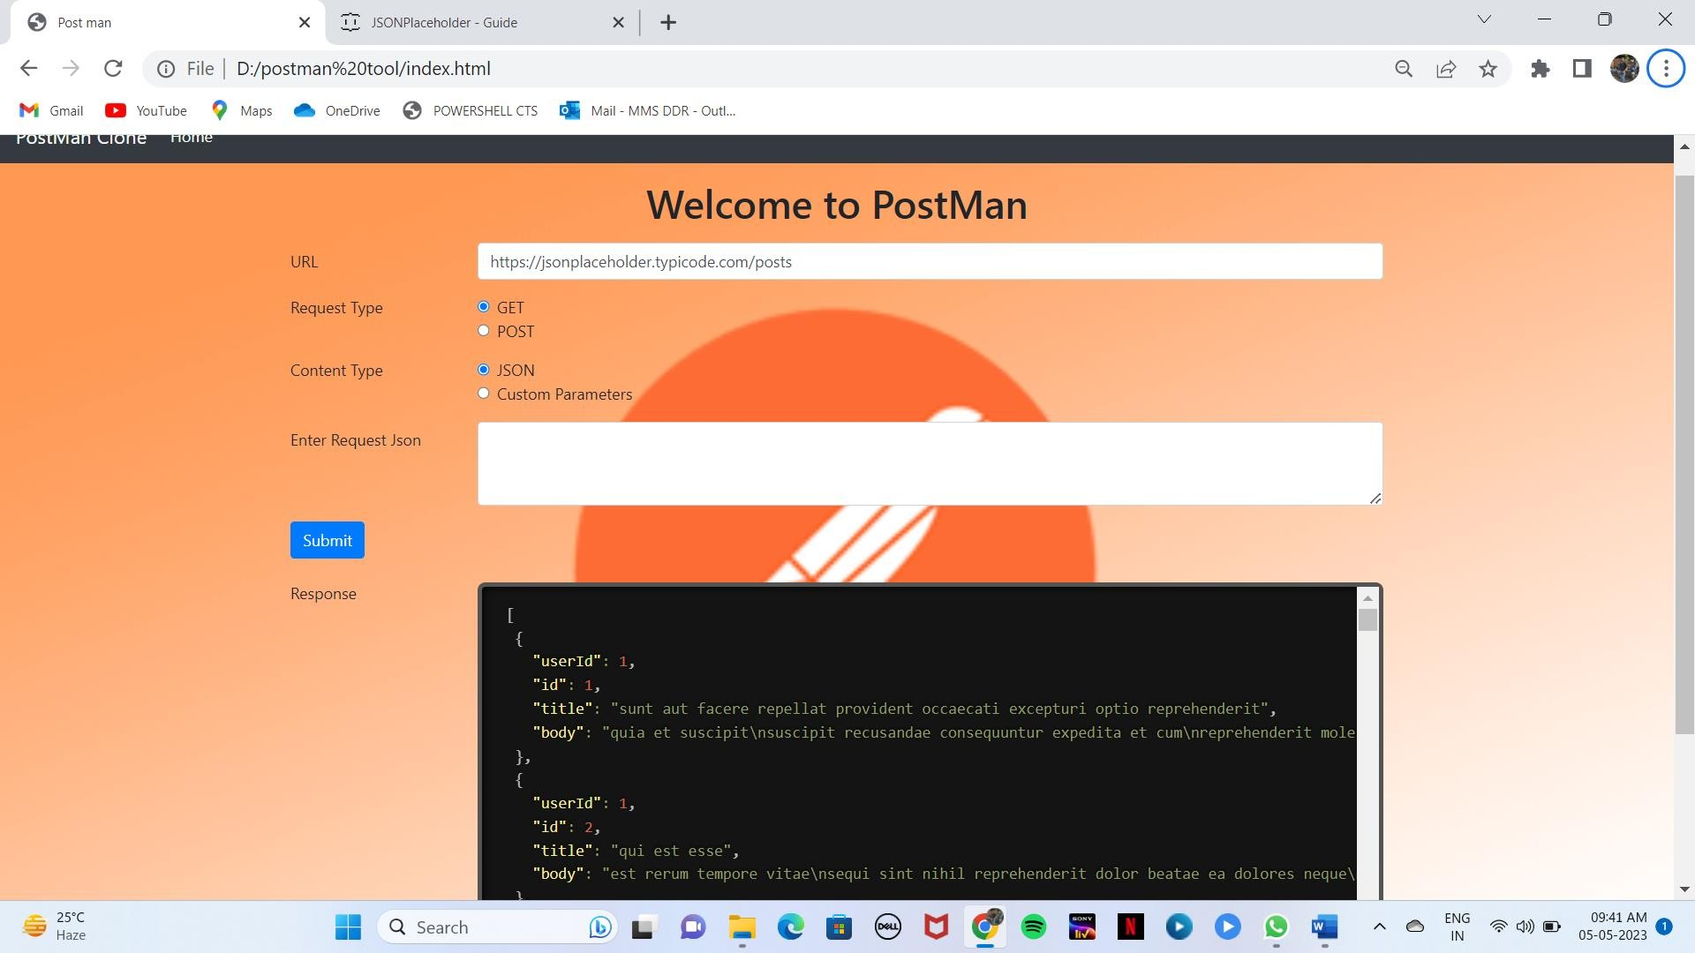
How to use postman tool

Slide 14
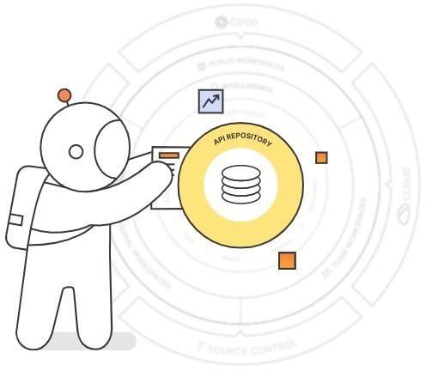
What is an API?
▶ API stands for Application Programming Interface. It is a set of rules and protocols that allows different software applications to communicate and interact with each other. APIs define the methods and data formats that applications can use to request and exchange information.
▶ In simpler terms, an API acts as a bridge between different software systems, enabling them to communicate and work together. It specifies how one software component can interact with another, allowing developers to access and use the functionality of a specific application, service, or platform.

Slide 15
Postman Tool Pricing
▶ Postman is available for free for individual use. For teams, Postman offers a range of plans, starting at $8 per user per month. Postman also offers an Enterprise plan for larger teams, which offers additional features and support.
▶ Postman also offers a free trial, allowing users to try out the features before committing to a plan. Postman also offers discounts for educational and nonprofit organizations.

Slide 16

Conclusion
▶ In conclusion, Postman is a powerful and versatile tool for API development, testing, and collaboration. It offers a range of features that streamline the API development process and enhance productivity. With Postman, you can easily build and send API requests, test and validate responses, organize requests into collections, and generate interactive API documentation. The tool supports automation, allowing you to write tests and perform complex workflows. Postman also facilitates collaboration among team members, with features for sharing collections, documentation, and test suites. It integrates with various tools and services and provides extensibility through its API. Overall, Postman simplifies API development, improves testing efficiency, and promotes effective collaboration, making it a valuable tool for developers and teams working with APIs.

Slide 17
▶ LAVANYA
▶ EKTA RAI

